Slide 1



Scheduling Algorithm Research.
Prototype a range of proposed scheduling algorithm improvements with dummy data
Final seminar
Presenter: David Long

Slide 2

Why Maintenance Scheduling Matters
In 1995, a US Army Blackhawk battalion reported 89% readiness. But when ordered to deploy, the commander mandated that no aircraft could deploy if it had less than 75 hours remaining until its next phase maintenance (Pippin, 1998).
9 of 24 helicopters were immediately non-deployable due to poor maintenance staggering.
This represented a massive loss of power.
(U.S. Army, 2018)
Notes:
Before introducing the technical side of the project, I want to begin with a real historical example that demonstrates why maintenance scheduling is so important.
During the 1995 United States Army Blackhawk deployment to Bosnia, a battalion reported an overall readiness level of 89 percent.
However, when deployment orders were issued, the commander required each aircraft to have at least 75 residual flight hours remaining before deployment.
Because the battalion had not properly staggered its aircraft maintenance cycles, nine out of the 24 helicopters were instantly deemed non-deployable.
As a result, the battalion experienced a major reduction in combat power despite appearing ready on paper.
This example highlights a key issue in fleet maintenance scheduling: high average readiness does not necessarily translate into operational readiness if maintenance events are poorly distributed.
This is the main motivation behind my project, developing optimisation algorithms that create smoother and more balanced maintenance schedules to maximise long-term fleet availability.

Slide 3

The Problem and Bottlenecks
Multiple aircraft exhaust their Residual Flight Time concurrently.
Finite resources such as dock space, mechanics, and components.
Aircraft undergo scheduled maintenance events
Random Failures can also happen.
This will cause volatility in availability of aircraft.
Notes:
High variance in availability happens when short term flight allocation causes multiple aircraft to exhaust their Residual Flight Time concurrently. If they all suddenly fail, there will not be enough resources such as dock space, mechanics and components to fix them all. This is why we need to stagger and space the maintenance checks out.
However, even if we manage to space the schedules out, random failures can also happen which causes disruptions in whole schedule, leading to a cascading effect.

Slide 4
Overview
Literature Review and Method Selection
Initial Simple Dataset
Best Improvement Neighbourhood Search
Extended Heavy Maintenance Dataset
Introducing Random Sampling Method for Heavy Dataset
Behaviour of Algorithm
Future Works

Slide 5
Literature Review and Method Selection
Mathematical Programming
Stochastic Simulation
Metaheuristic Algorithms
Selected approach: Simulated Annealing with Variable Neighbourhood Search (SAVNS) (Winata, 2011)

Slide 6

Initial Dataset
Simple Dataset provided by Tim
10-aircraft fleet maintenance schedule
8 maintenance event with each even lasting 60 days
Maintenance windows constrained to 320–380 days
Initial random schedule caused heavy maintenance overlap
Goal: stagger maintenance checks to maximum of 2 aircraft offline

Slide 7


Best-Improvement Neighbourhood Search

Slide 8


Extended Heavy maintenance dataset
Maintenance Cycle: A → B → A → C → A → B → A → D
Minimum forecast length: 12 years
Represents 1.5 maintenance cycles
24 Aircraft having 11-12 maintenance events per forecast

Slide 9
Optimised Heavy dataset using Random Sampling
Initial neighbourhood search worked on smaller dataset but too slow for heavy dataset
Scaling to 24 aircraft made the search generate over 1000 schedules per iteration
Random sampling strategy introduced
Only 200 neighbouring schedules are evaluated which is sufficient to identify better local solutions.

Slide 10

Optimised Heavy maintenance dataset
Original
Min Availability: 15
Availability S.D.: 1.947
Average Availability: 21.694
Optimised
Min Availability: 18
Availability S.D.: 1.433
Average Availability: 21.712

Slide 11
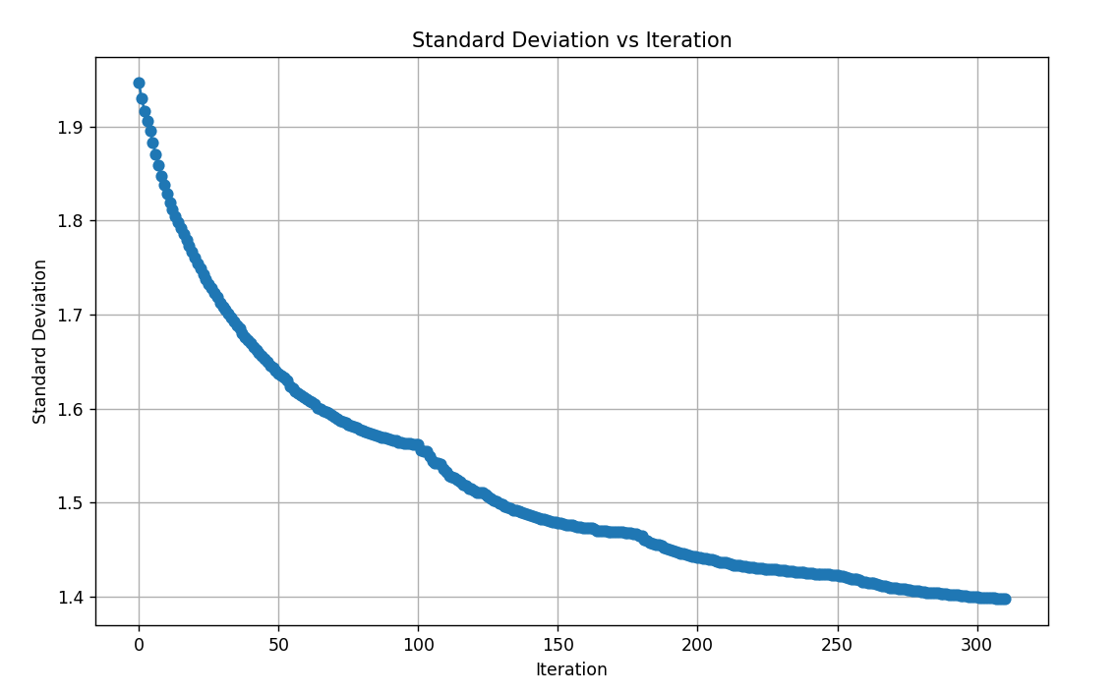
Convergence Behaviour of Variable Neighbourhood Search
Standard Deviation of fleet availability decreases over iterations
Final value converges to ~1.40
Around iteration ~100, the algorithm transitions between shift sizes
Earlier iterations relied on large shift sizes (±28)
Later iterations focused on local optimisation (±14, ±7, ±3)
Algorithm terminated at iteration 311 (no improvement found)

Slide 12
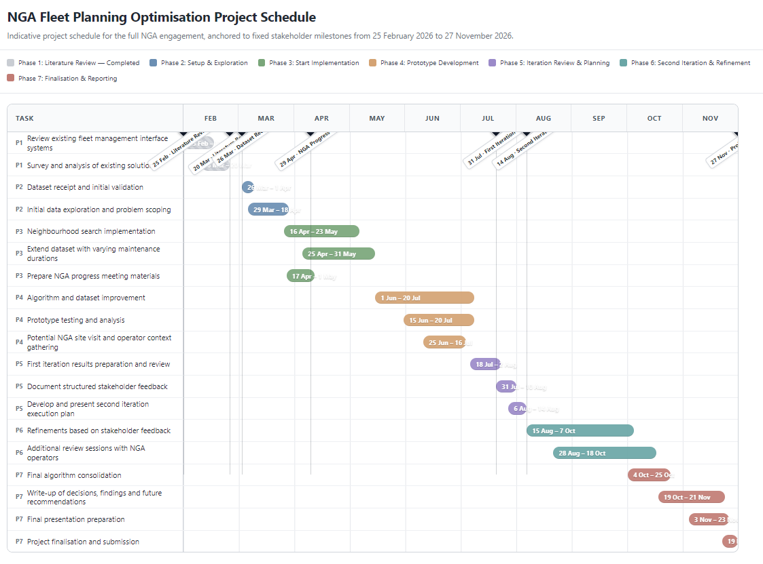
Future Work and Research Direction
Semester 2 (Iteration 2)
Investigate Simulated Annealing + VNS hybrid optimisation
Include additional operational and logistic constraints (in these 3 months, maximise availability, can change surrounding) (standard deviation inside the window)
Improve computational efficiency
Analysis of Hyperparameters
Look at the start to see if initial stagger changes outcome
Exploit left to right nature of timeline (start from left)

Slide 13
ITERATION 1 RECAP
Priority VNS delivered a practical baseline
MINIMUM AVAILABILITY
RUNTIME
15 → 18 aircraft
~15.4 seconds
What works well and what is still limited
• We focus first on maintenance that hits the worst availability days.
• When we move a check, we rebuild that aircraft’s later schedule so rules stay valid.
• We update availability cheaply instead of recalculating from scratch.
• Currently we only accept better moves and we stop when nothing improves.
Notes:
Just a quick recap of what I have done.
On the heavy dataset, we raised the worst-day availability from fifteen aircraft to eighteen, in about fifteen seconds.
What works well is how we search: we focus on the worst days, rebuild an aircraft’s plan when we move a check, and update availability cheaply.
What is still limited is decision-making. Right now, we only keep better moves, and we stop when nothing improves. That is why we are looking at simulated annealing in iteration 2.

Slide 14
SIMULATED ANNEALING
What simulated annealing is
1 · Search
2 · Accept
3 · Cool down
Same priority-based selection neighbour search algorithm
Better moves are always kept. Worse moves can still be kept early on, by chance.
Over time we accept fewer worse moves, so the search settles on a strong plan.
Why it helps
Think of the search like walking over hills. Today’s method only walks uphill. That is fast and safe, but you can get stuck on a steep part of the hill when a better peak is nearby.
Simulated annealing sometimes takes a downhill step early, so you can leave a trap and reach a better overall schedule. As the search “cools,” those downhill steps become rare, and we settle on the best plan we found.
Notes:
So what is simulated annealing.
Simulated annealing is a search method. The idea comes from metalworking: heating metal allows it to bend, then cool it slowly so it settles into a strong structure. In optimisation, “heat” means we are more willing to try unusual moves. “Cooling” means we become stricter over time.
There are three simple steps.
First, search. We propose a change to the maintenance schedule — for example, shift a check a few days earlier or later — then evaluate the new plan with the same availability score we already use: minimum availability first, then smoothness, then average. We are not inventing a new scoring system here.
Second, accept. If the new plan is better, we keep it. That part is familiar. The difference is early in the search we may also keep a slightly worse plan, by chance. That sounds odd, but it is deliberate. A temporary worse move can get us out of a local minima.
Third, cool down. As the search continues, we accept fewer and fewer worse moves. Near the end, we mostly behave like today’s method: keep improvements, reject clear steps backwards.
So if we were walking up a hill, sometimes we might need to take a step downhill just to find a better path rather than constantly going up a hill that might be steep. If we accept worse moves temporarily, we might find an easier path.
What annealing does need later is a fair acceptance rule for those temporary worse moves — because our score is a ranked tuple, not one number. That is an acceptance detail, not a new objective. Next I will show how this idea maps onto the optimiser we already built.

Slide 15
HOW IT FITS
How annealing fits into our design
KEEP · How we search today
CHANGE · How we accept moves
• Focus on the worst availability days first
Rebuild the aircraft schedule after each move
Update availability without recalculating everything
Try larger timing shifts, then smaller ones
Currently: only keep the improving moves
New method: annealing accept better moves always, worse moves sometimes, depending how early and late
Drop best improvement strategy so worse candidates can be tried
Verdict: Keep how we find candidate moves. Change how we decide which moves to accept.
Notes:
So how does annealing fit our design?
We will keep how we still focus on the worst availability days first. We still rebuild an aircraft’s schedule after a move, so the A, B, C, D rules stay valid. We still update availability cheaply instead of recalculating everything. We still try larger timing shifts, then smaller ones. And we still remember the best schedule we have seen so far.
On the change side: currently we only keep improving moves. That is classic hill-climbing. The new method is annealing acceptance — better moves always; worse moves sometimes, more early, less later. We also drop the improve-only early-exit so worse candidates can actually be tried.
So the fit is clean if we think in layers. Annealing does not replace how we find candidate moves. It replaces how we decide whether to accept them. Keep the smart search. Change the acceptance rule.
Next I will show the hybrid design in one line.

Slide 16
FAIR ACCEPTANCE
Fair testing
1 · Better plan?
2 · Worse worst-day?
3 · Same floor?
If the new schedule improves worst-day availability, keep it. That always comes first.
If it lowers the minimum availability, reject it. Do not accept a “smoother” plan that makes the busiest day worse.
If the worst day is unchanged, but the plan is bumpier or lower on average, allow it sometimes early, less often as the search cools.
What we report, and how we test
Because annealing is random, run the full search 3 times and report the typical result. Current priority selection NS method needs one run, do not compare the best of three with one baseline run.
Notes:
This slide covers two things: how we treat a worse move, and how we know which plan to keep.
Checklist. If the new schedule improves the worst day, keep it. If it makes the worst day worse, reject it. If the worst day stays the same but the plan is bumpier, annealing may accept that sometimes early, less often later.
We keep two plans. Current can go downhill so we can keep searching from it. Best-so-far only updates when something beats it — that is what we report.
Because annealing is random, we run the full search three to five times. We report the typical result, not the lucky best. Today’s method is deterministic, so one run is enough. Do not compare best-of-five annealing with one baseline run.

Slide 17
COMPARISON
Basin-hopping did not clear the keep rule
WORST DAY
SPREAD
18 aircraft
for every method
1.390 vs 1.392
bar was 0.005
Same heavy forecast. Lower spread is the smoother plan.
• Tuned hill-climb, one run: spread 1.392, about 116 seconds.
• Basin-hopping, median of seeds 1–3: spread 1.390, about 306 seconds. Two seeds ran past five minutes.
• Tightened acceptance, which keeps the worst day from falling, matched the hill-climb at 1.392.
• The keep rule asked for a 0.005 smoother plan, worst day still 18, and a typical run within five minutes.
Notes:
Just a quick recap of what I have done.
On the heavy dataset, we raised the worst-day availability from fifteen aircraft to eighteen, in about fifteen seconds.
What works well is how we search: we focus on the worst days, rebuild an aircraft’s plan when we move a check, and update availability cheaply.
What is still limited is decision-making. Right now, we only keep better moves, and we stop when nothing improves. That is why we are looking at simulated annealing in iteration 2.

Slide 18
STARTING POINT
Separate start effect from algorithm gain
Why the start matters
What we will do
The search only makes local moves from the original plan.
A well-staggered start can look like a better algorithm.
A bunched start can make a good method look weaker.
Build a few controlled starts: bunched, as-loaded, and more spread out.
Run current method and annealing from each of those same starts.
Document how much the initial stagger impacts the optimisation.
Priority targeting does not cancel this.
It only chooses which events to try first. Days that are not the current worst days keep the original stagger, so a good start can still do some of the work.
Notes:
Fourth: the starting schedule.
Our method starts from the loaded plan and only makes local changes. A well-staggered start can make the final result look better than the algorithm alone deserves. A bunched start can make a good method look weak. A “win” might just be a luckier start.
Priority-based selection does not make that start irrelevant. It only chooses which events to try first — those sitting on the worst availability days. If a worst-day event has an improving move, other events are not even considered that iteration. So non-bottleneck stagger is mostly inherited from the loaded plan. That is a reason to test controlled starts, not a reason to skip them.
So we will build a few controlled starting plans — bunched, as-loaded, and more spread out — and run the same search from each.
Today’s method and annealing get those same starts. We only call annealing better if it wins from the same starting plans. That keeps the comparison honest.

Slide 19
OPENING STAGGER
The as-loaded opening still finishes smoothest
AS LOADED
BUNCHED
Spread 1.392
in 63 seconds
Spread 1.405
in 48 seconds
Every opening starts at a worst day of 15 and finishes at 18
• Spread opening: finished spread 1.417, in 93 seconds.
• Figures are the tuned hill-climb. Basin-hopping was about 0.001 to 0.003 smoother on each opening, and slower.
• Bunching or spreading the first checks leaves a bumpier finished plan.
• The as-loaded forecast remains the start we keep.
Notes:
Just a quick recap of what I have done.
On the heavy dataset, we raised the worst-day availability from fifteen aircraft to eighteen, in about fifteen seconds.
What works well is how we search: we focus on the worst days, rebuild an aircraft’s plan when we move a check, and update availability cheaply.
What is still limited is decision-making. Right now, we only keep better moves, and we stop when nothing improves. That is why we are looking at simulated annealing in iteration 2.

Slide 20
DECISION CRITERIA
What we will keep, and when we stop
Keep it if:
Drop it if:
Worst-day availability must be as good as current algorithm.
Runtime does not increase too much.
New operational rules still produce legal, usable schedules.
The gain is from the method, not a luckier start or a luckier seed.
Annealing does not beat the current method, and we will keep the current method.
Worse moves start hurting the minimum availability, we tighten the acceptance rule.
New constraints break feasibility.
Notes:
What we will keep, and when we stop.
Keep annealing if the worst-day availability is at least as good as today, and it is not much slower. New operational rules still have to produce legal, usable schedules. And the gain has to come from the method — not a luckier start or a luckier random seed.
If annealing does not beat today’s method, we keep today’s method. If worse moves start hurting the worst day, we tighten the acceptance rule. If new constraints break feasibility, we do not ship them.
We only keep what the evidence supports.
Happy to take questions.

Slide 21
WHAT WE KEEP
The tuned hill-climb is the method we take forward
KEEP
SET ASIDE
Hill-climb
As-loaded start
Basin-hopping
Gain of 0.001
In short
• Priority search, rebuild after each move, and accept an improving plan only.
• Half-step shifts are passed in. The published Iteration 1 defaults stay as they were.
• The spread gain was 0.001, short of 0.005, and the typical run passed five minutes.
• Tightened acceptance found the same plan as the hill-climb.
Notes:
Just a quick recap of what I have done.
On the heavy dataset, we raised the worst-day availability from fifteen aircraft to eighteen, in about fifteen seconds.
What works well is how we search: we focus on the worst days, rebuild an aircraft’s plan when we move a check, and update availability cheaply.
What is still limited is decision-making. Right now, we only keep better moves, and we stop when nothing improves. That is why we are looking at simulated annealing in iteration 2.

Slide 22
HYPERPARAMETERS
To be added.
Notes:
Just a quick recap of what I have done.
On the heavy dataset, we raised the worst-day availability from fifteen aircraft to eighteen, in about fifteen seconds.
What works well is how we search: we focus on the worst days, rebuild an aircraft’s plan when we move a check, and update availability cheaply.
What is still limited is decision-making. Right now, we only keep better moves, and we stop when nothing improves. That is why we are looking at simulated annealing in iteration 2.

Slide 23
References
Pippin, Bradley W. Allocating Flight Hours to Army Helicopters. PhD thesis, Naval Postgraduate School, 1998.
U.S. Army, Black Hawk helicopter celebrates 40 years of aviation service with the Army, 2018.
Winata, Leonard. Heuristic approaches for flight and maintenance planning of Large Fleets. Doctor of Philosophy Thesis, RMIT University, 2011.

